Slide 1

Introduction & Descriptiive Statistics

Slide 2
Objectives
Introducing the basics of descriptive statistics- mean, median, mode, variance, and standard deviation.
Understand the usefulness of the measures of central tendency and dispersion for different levels of measurement.
Analyze a data set to determine which type of visualization can be used to represent it.
Interpret data visualizations.
Create data visualizations that compare two data sets.
Create data visualizations that show how data are distributed in Python.
Introduction & Descriptiive Statistics

Slide 3
Measure of Central Tendency
The measures of central tendency are the most commonly used in statistical analysis.
We know them as mean, median, and mode and their use is ubiquitous and statistical analysis.
Population: all items of interest for a particular decision or investigation
  All drivers in Vietnam
  All individuals who do not own a cell phone
Sample: a subset of a population
  All married drivers in Vietnam over age 30
Introduction & Descriptiive Statistics

Slide 4
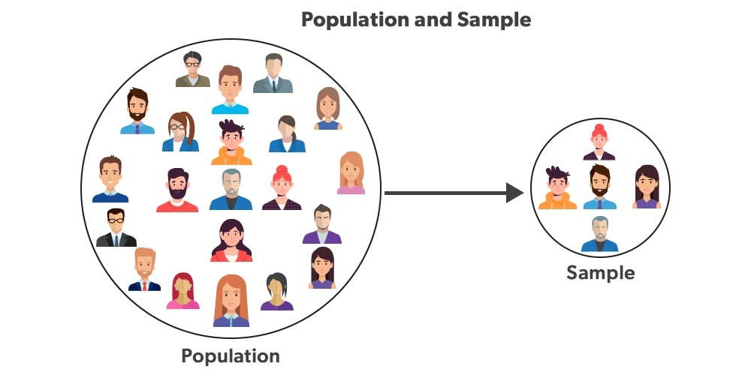
Measure of Central Tendency
Why samples are used?
  To reduce cost of data collection
  When a full census cannot be taken
Introduction & Descriptiive Statistics

Slide 5
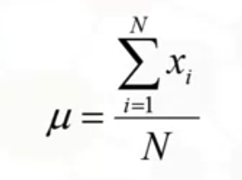
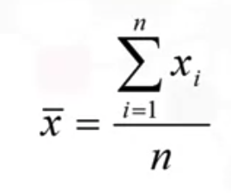
Mean or Average
Mean: in mathematics, a quantity that has a value intermediate between those of the extreme members of some set.
Population mean:
Sample mean:
Introduction & Descriptiive Statistics

Slide 6
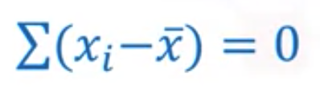
Mean or Average
It is the sum of all the observations, then, divide it by the number of observations to get the mean, which we call averages.
There are several properties of the mean and they are meaningful.
But one of the characteristics of a mean is that if you take the difference between the average value for a variable, and subtract from all the observations and sum them up. That sum would be equal to zero.
Introduction & Descriptiive Statistics

Slide 7
Median
The median is different from the mean.
When you order the data from the smallest value to the largest value, the result is in the middle.
That is, the value in the middle indicating that there are an equal number of observations, that are above and the equal number of observations are below that family.
  Unique for each set of data
  Not affected by extremes
  Meaningful for ratio, interval, and ordinal data
Introduction & Descriptiive Statistics

Slide 8
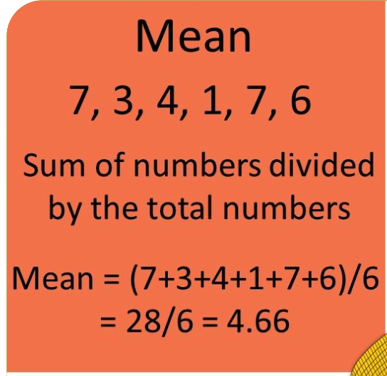
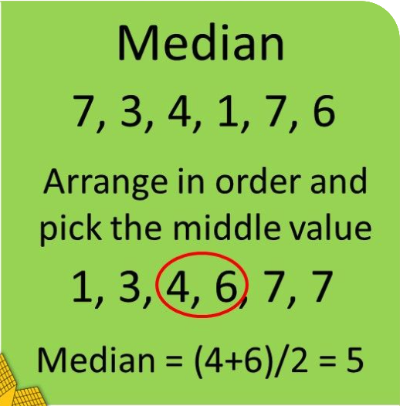
Mean and Median
Introduction & Descriptiive Statistics

Slide 9
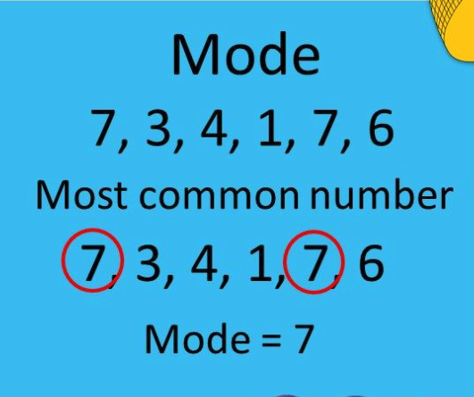
Mode
Mode is essentially the value that occurs most frequently; for grouped data, the midpoint of the cell with the largest frequency( approximate value)
  Useful when data consist of a small number of unique values
Introduction & Descriptiive Statistics

Slide 10
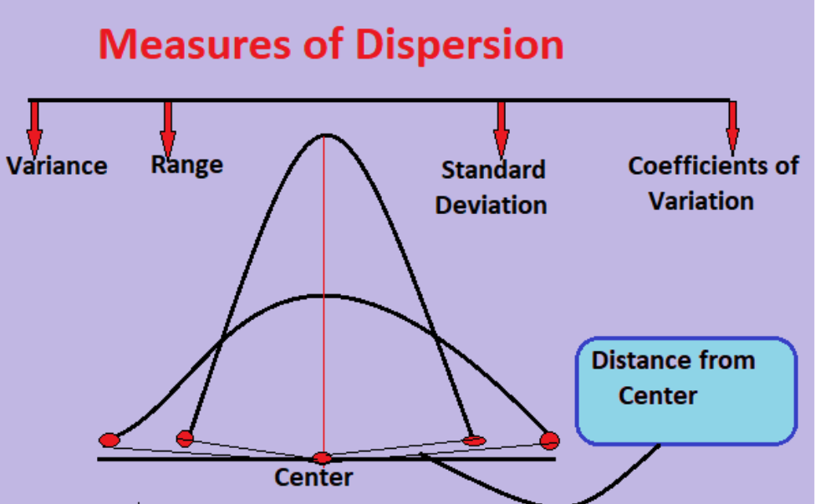
Measure of Dispersion
Dispersion, which is also called variability, scatter or spread, is the extent to which the data distribution is stretched or squeezed.
The common measures of dispersion are standard deviation and variance.
Introduction & Descriptiive Statistics

Slide 11
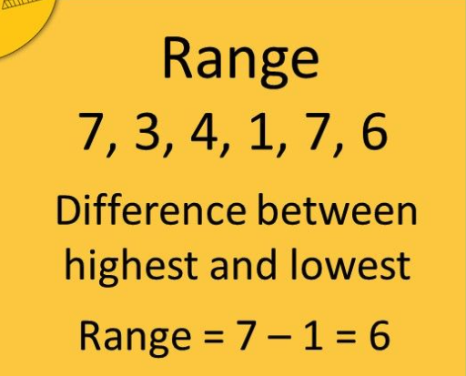
Measure of Dispersion
Dispersion is the degree of variation in the data
  The age of instructors { 48, 49, 50, 51, 52}
Range is the difference between the maximum and minimum observations
  The minimum age of an instructor was 29 and maximum age was 73
Introduction & Descriptiive Statistics

Slide 12
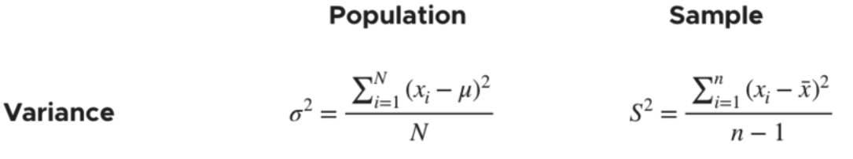
Variance
Variance is the expectation of the squared deviation of a random variable from its population mean or sample mean..
Introduction & Descriptiive Statistics
Notes:
Variance is a measure of dispersion, meaning it is a measure of how far a set of numbers is spread out from their average value

Slide 13
Variance
According to layman’s words, the variance is a measure of how far a set of data are dispersed out from their mean or average value. It is denoted as ‘σ²’.
Properties of Variance
  It is always non-negative since each term in the variance sum is squared and therefore the result is either positive or zero.
  Variance always has squared units.
Introduction & Descriptiive Statistics
Notes:
For example, the variance of a set of weights estimated in kilograms will be given in kg squared. Since the population variance is squared, we cannot compare it directly with the mean or the data themselves.

Slide 14
Standard Deviation
The degree of dispersion is computed by the method of estimating the deviation of data points: ‘σ’.
Properties of Standard Deviation
  It describes the square root of the mean of the squares of all values in a data set and is also called the root-mean-square deviation.
  The smallest value of the standard deviation is 0 since it cannot be negative.
  Data values of a group are similar: standard deviation➔very low or close to zero.
  Data values vary with each other: standard variation ➔high or far from zero.
Introduction & Descriptiive Statistics

Slide 15
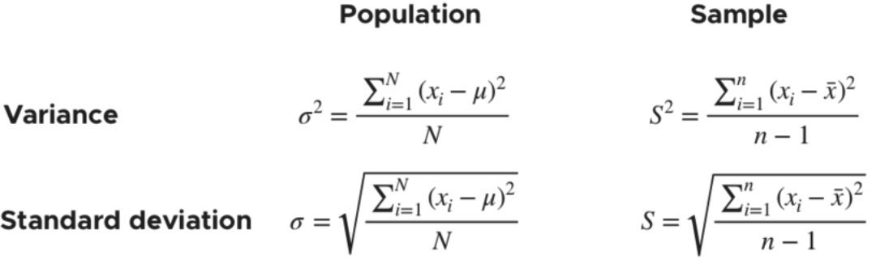
Standard Deviation
The variance of the data set is the average square distance between the mean value and each data value. And standard deviation defines the spread of data values around the mean.
Introduction & Descriptiive Statistics

Slide 16
Summary
Introducing the basics of descriptive statistics- mean, median, mode, variance, and standard deviation.
Understand the usefulness of the measures of central tendency and dispersion for different levels of measurement.
Analyze a data set to determine which type of visualization can be used to represent it.
Interpret data visualizations.
Create data visualizations that compare two data sets.
Create data visualizations that show how data are distributed in Python.
Introduction & Descriptiive Statistics

Slide 17
Q & A
Introduction & Descriptiive Statistics

